Slide 2


How we used Delphi as a weapon in a real fight - and won
Ian Barker
Embarcadero Delphi MVP
ian.barker@gmail.com
@punctuation
about.me/IanBarker
Slides, link & replay tinyurl.com/delphivscompetition

Slide 3



Winston Churchill described the staff at the ultra top-secret Bletchley Park as “the goose that laid the golden eggs but never cackled”
How we used Delphi as a weapon in a real fight - and won

Slide 4


The trouble with Delphi is that it is silently successful In almost any given situation it is the best choice, fastest to market, almost always with the lowest amount of code It is rock solid – Delphi programs run for years, surviving multiple upgrades to the operating system and never making a squeak while it lays the golden eggs
How we used Delphi as a weapon in a real fight - and won

Slide 5

Delphi is the software equivalent of Churchill’s silent goose that lays the golden eggs Bigger marketing budgets make a lot of noise in other directions But, in a fair fight, how would RAD Studio actually do?
How we used Delphi as a weapon in a real fight - and won

Slide 6


Embarcadero decided to sponsor some comparison research Is RAD Studio with Delphi really any good compared to popular alternatives?
How we used Delphi as a weapon in a real fight - and won

Slide 7
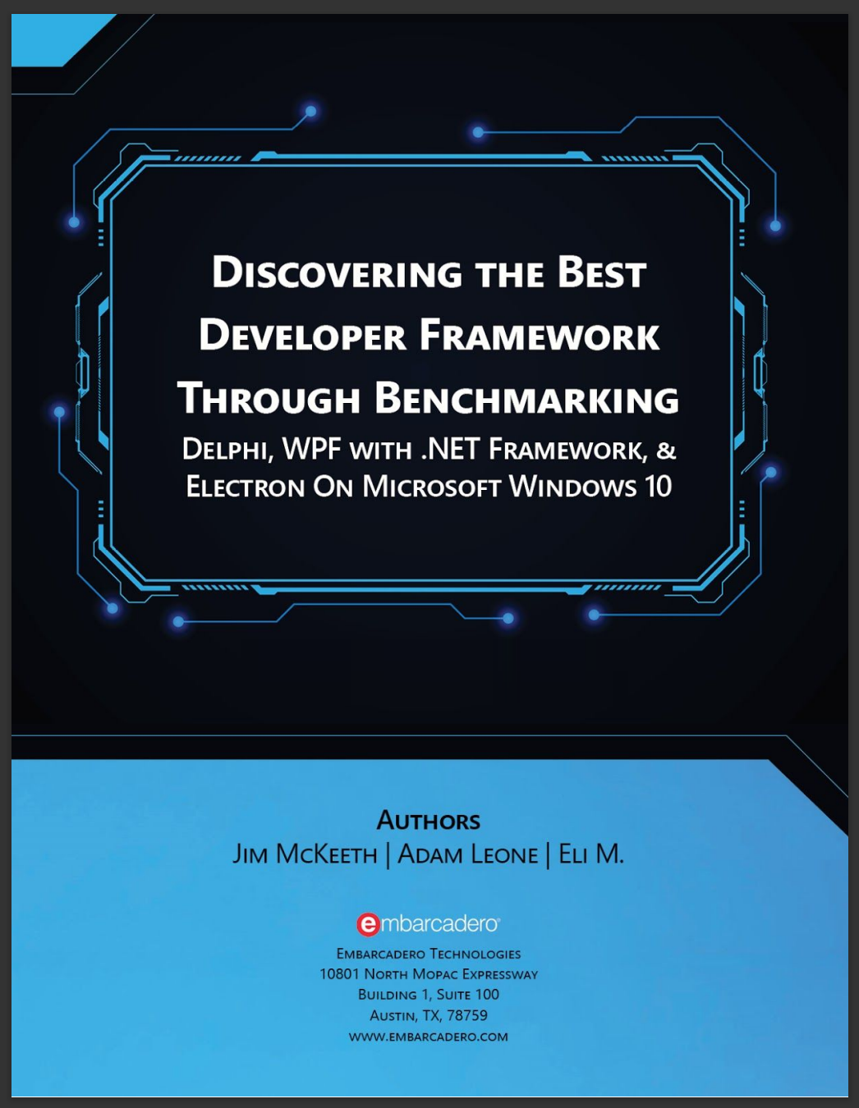
The methodology and results are described in a freely available white paper
How we used Delphi as a weapon in a real fight - and won
https://lp.embarcadero.com/Discovering_the_best_framework

Slide 8


The frameworks chosen were
How we used Delphi as a weapon in a real fight - and won
RAD Studio with Delphi
Microsoft .NET using WPF
Electron

Slide 9
Let’s be clear, the competing frameworks were not chosen because they were lame or obscure Quite the opposite… They were chosen because they are popular, widely-used, current, and experienced developers could be found to make it a fair competition
How we used Delphi as a weapon in a real fight - and won

Slide 10
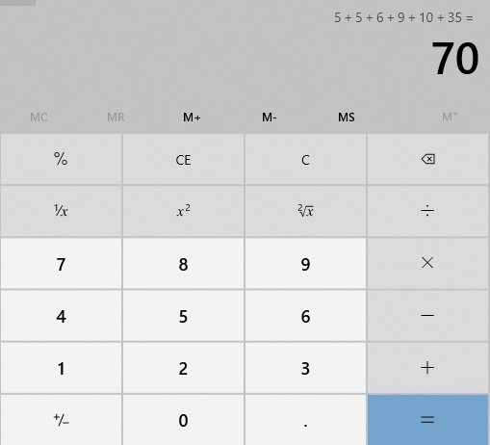
There was a choice of challenges The project I was involved in was to recreate the Windows calculator app
The challenge
This sounded easy to me and because I am very lazy busy it sounded ideal

Slide 11
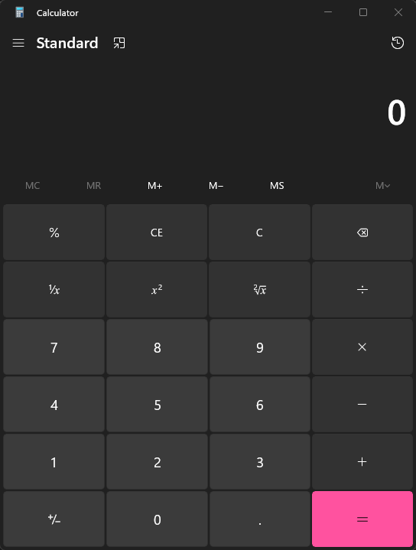
The requirement was to pick a framework of your choice – VCL or FireMonkey FMX
FireMonkey FMX or VCL?
And code the app in that framework as quickly and accurately as you possibly can

Slide 12

If I planned the app out correctly, I could create multiple versions from the same code base
Then I had a really dumb SMART Idea
Why write one app when you can write eight?

Slide 13

In fact…
Then I had a really dumb smart idea
Why write one app when you can write nine?

Slide 14
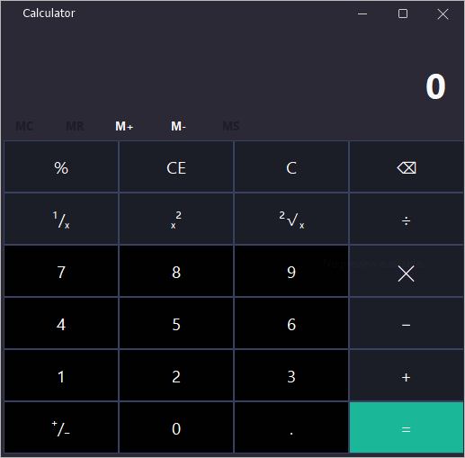
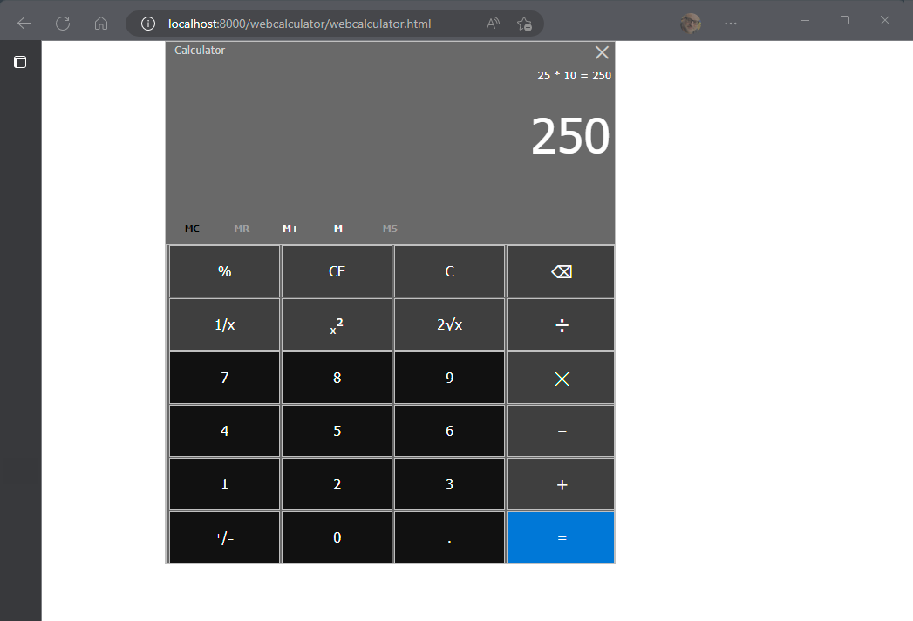
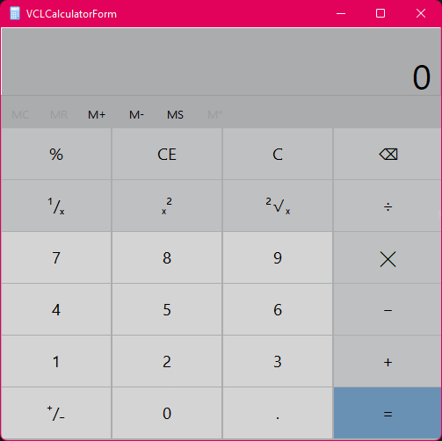
So, I decided to create…
Taking advantage of Delphi
Windows plain VCL
Windows FluentUI VCL
Windows FireMonkey FMX
macOS
iOS
Android
Conventional web app
Progressive web app (PWA)

Slide 15

Oh…
Taking advantage of Delphi
..and an Electron app
Written in Delphi…

Slide 16
VCL is easy so we just use the default controls
Picking the frameworks
FireMonkey is similarly powerful
For the FluentUI version I chose the StyleControls from AlmediaDEV
https://www.almdev.com/prods/stylecontrols/stylecontrols.html
For all web app types I used TMS WEB Core
https://web.tmssoftware.com

Slide 17
If I want to target very different user interfaces, then it is vital that the UI is separated from the implementation of the actual ‘calculator’ code
Design
The other thing to be careful of is that VCL, FireMonkey, and web apps have different properties and event models

Slide 18
The obvious choice to enforce the separation of UI and calculation code itself is to create an IInterface
Design
TxxxCalculatorForm VCL form, FMX form, html
ICalculator the interface
TCalculator the concrete class

Slide 19
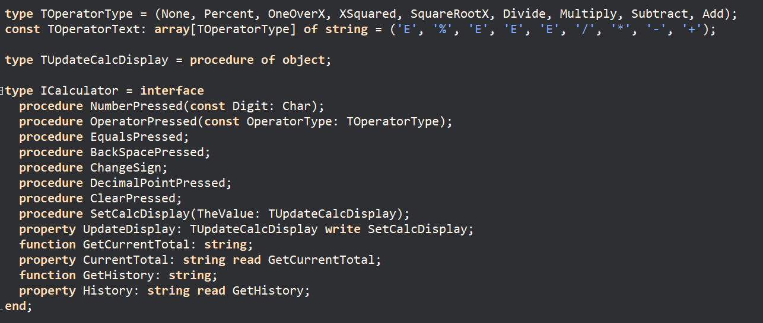
The interface allows us to write the UI code so that it doesn’t use a concrete implementation
implementation

Slide 20
It defines the actions that the user can initiate such as addition, subtraction, display the total and even maintain a history
iCalculator interface

Slide 21
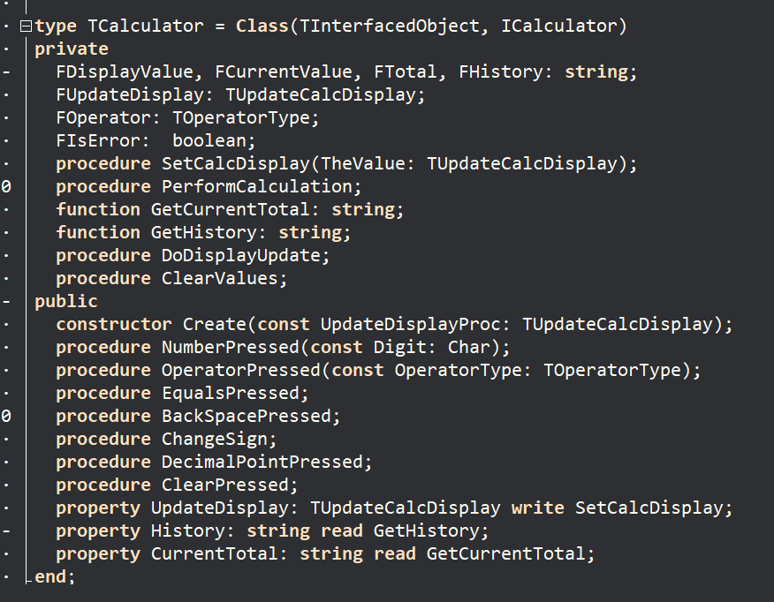
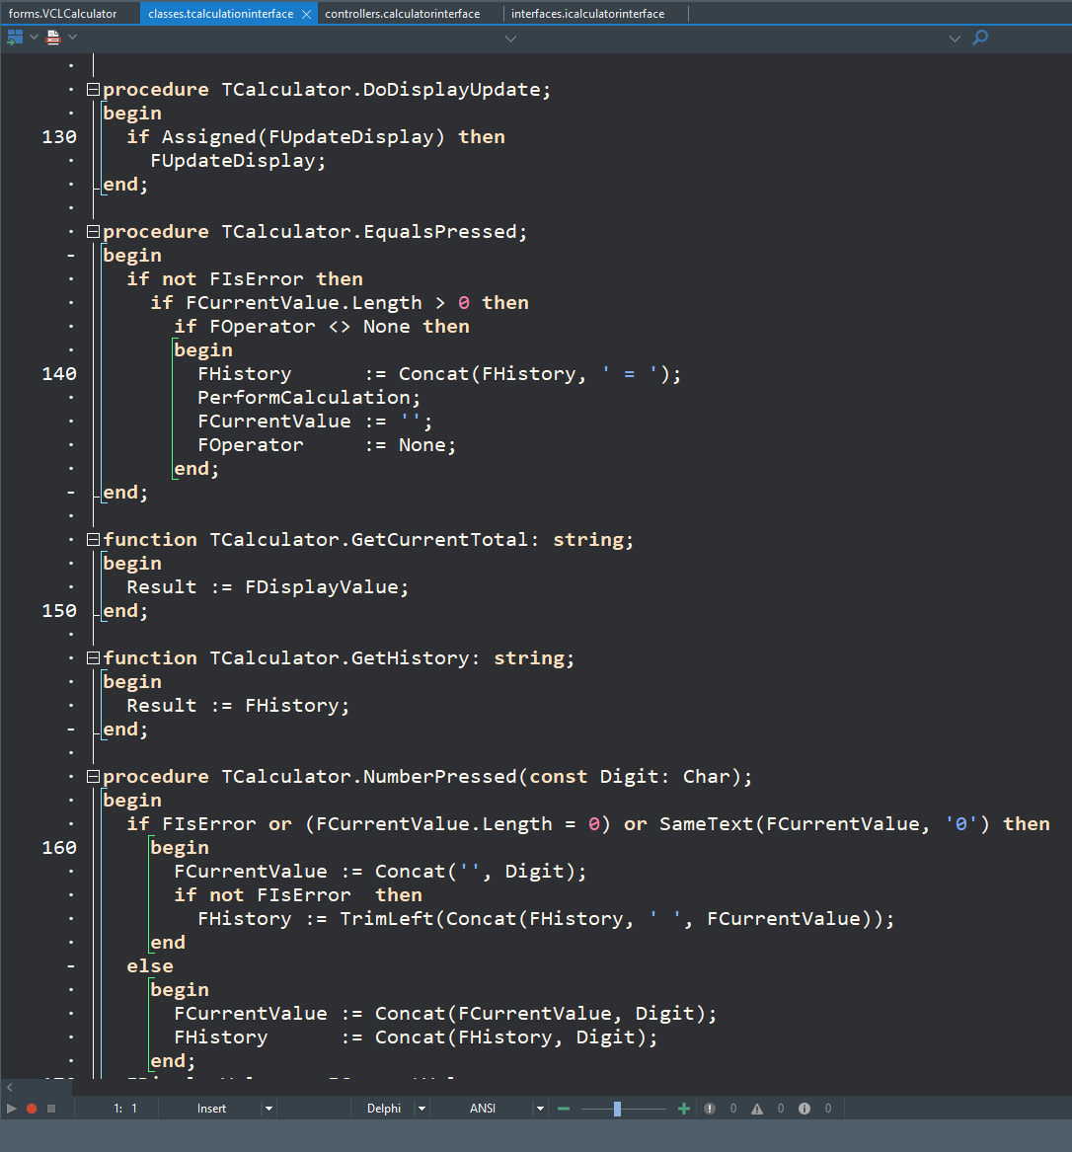
Implements the ICalculator interface and does the actual work
Tcalculator class

Slide 22
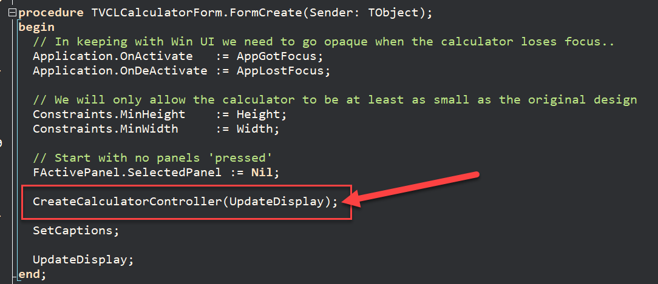
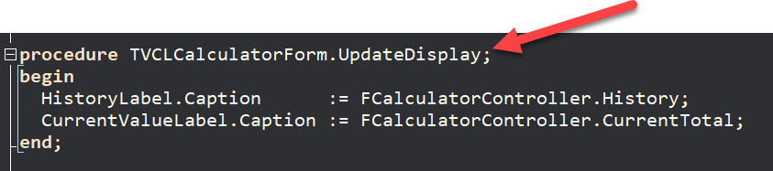
Web apps are asynchronous by default plus good practice is to never update the UI directly So, I implemented a callback to display the results when required
updating the display

Slide 23
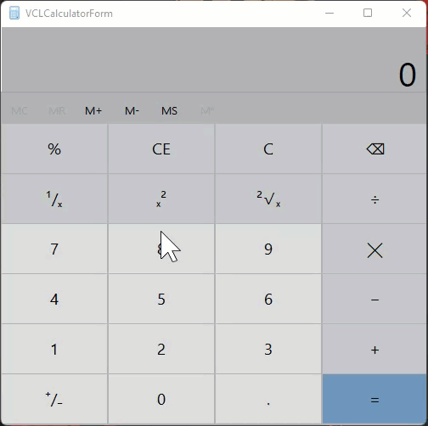
If you really looked at the genuine calculator app it had some subtle visual behavior
Subtleties of the implementation
The buttons would flash when clicked
And the form is partially transparent – until you clicked away from the app

Slide 24
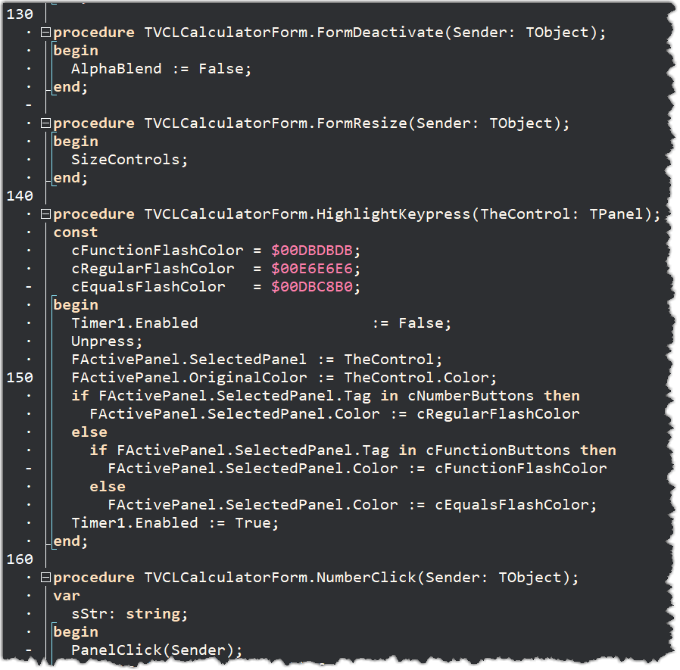
All that behavior was entirely cosmetic The actual form could handle that Each framework was diverse – web buttons work very differently to native buttons This meant there was no obvious advantage in creating a generic visual controller
Subtleties of the implementation

Slide 25
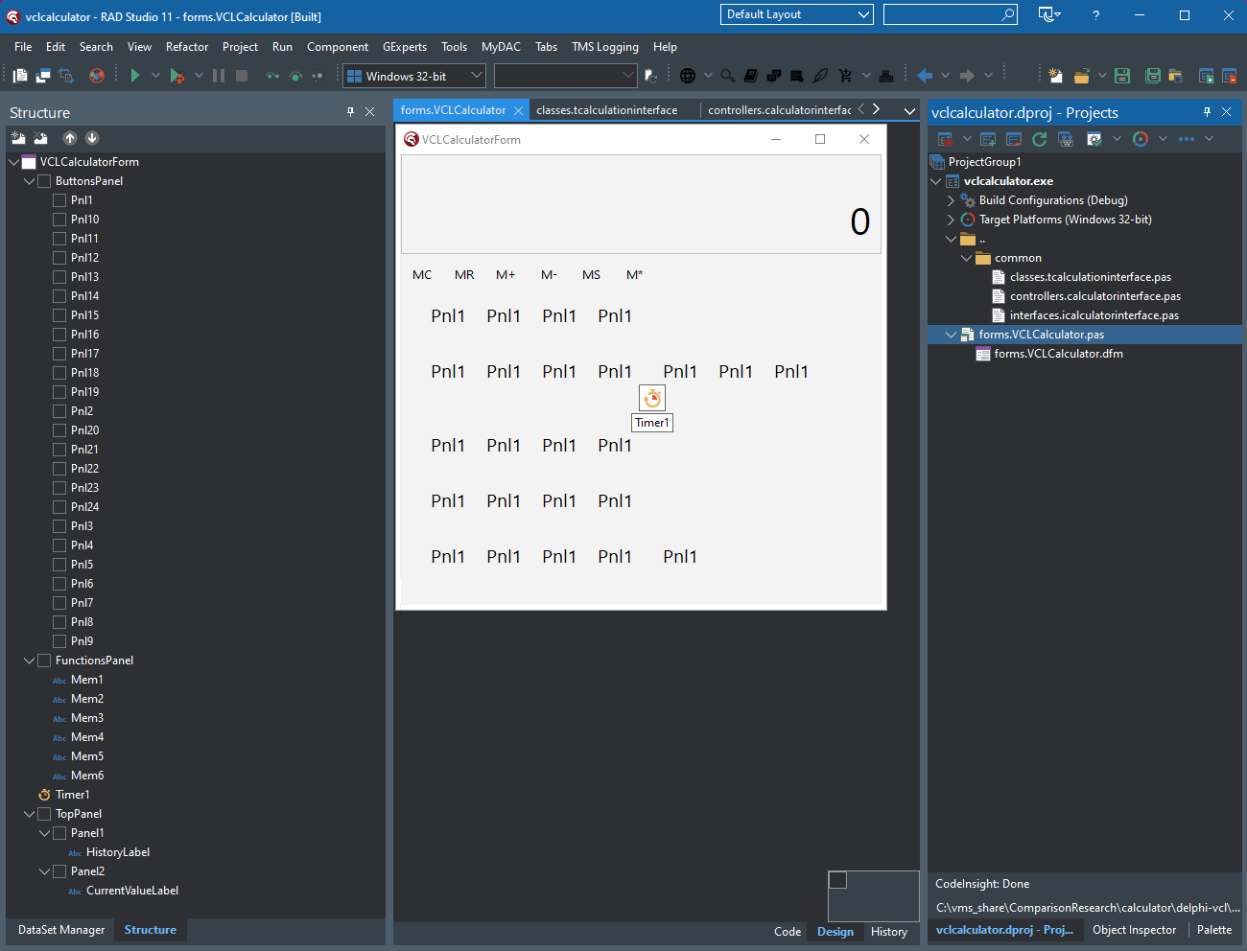
All I had to do was to create the main form for the project and the interface, controller, and class would do the rest This is the VCL and FMX versions
Subtleties of the implementation

Slide 26
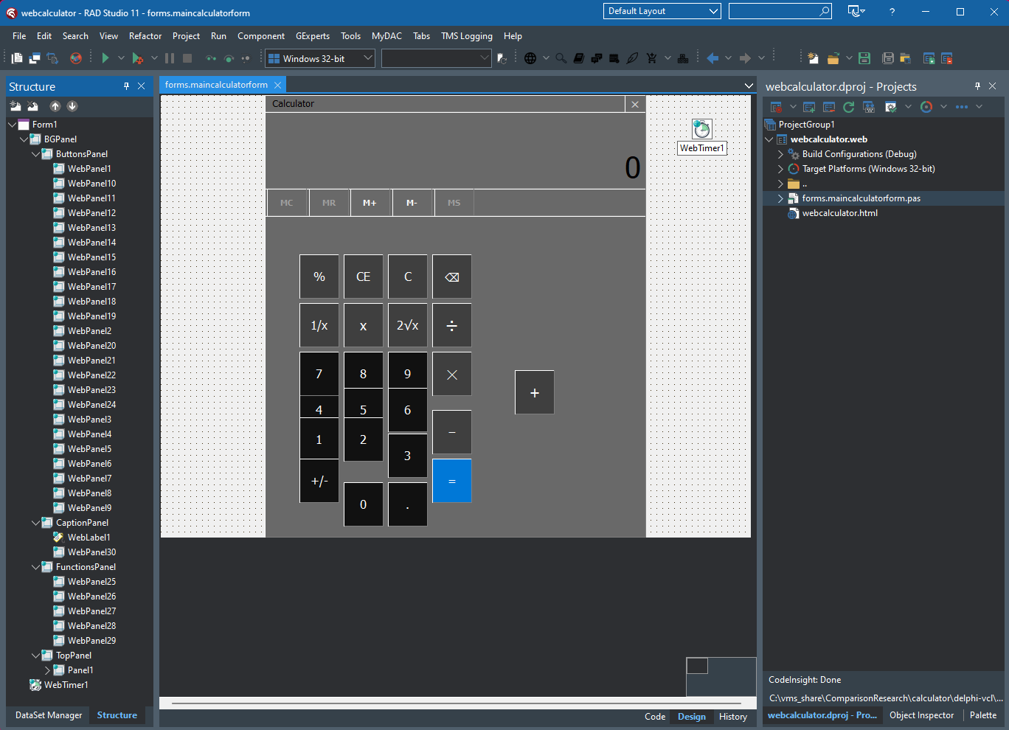
This is the FluentUI version
Subtleties of the implementation

Slide 27
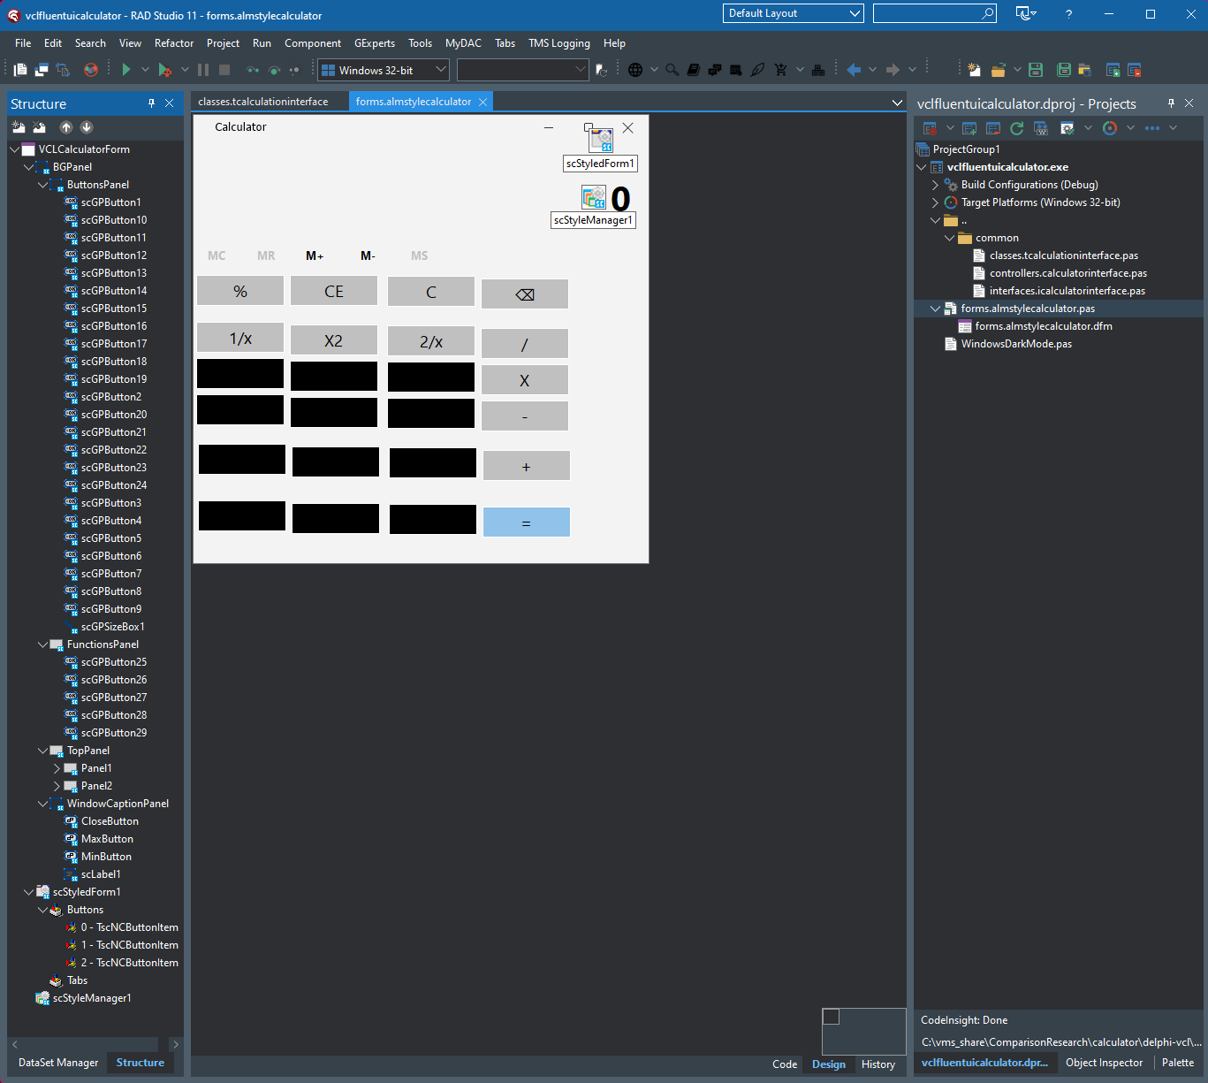
And this is the TMS WEB Core version This same project produced a pure HTML web app, a progressive web app (PWA) AND an Electron app just to mock the opposition😁
Subtleties of the implementation

Slide 28
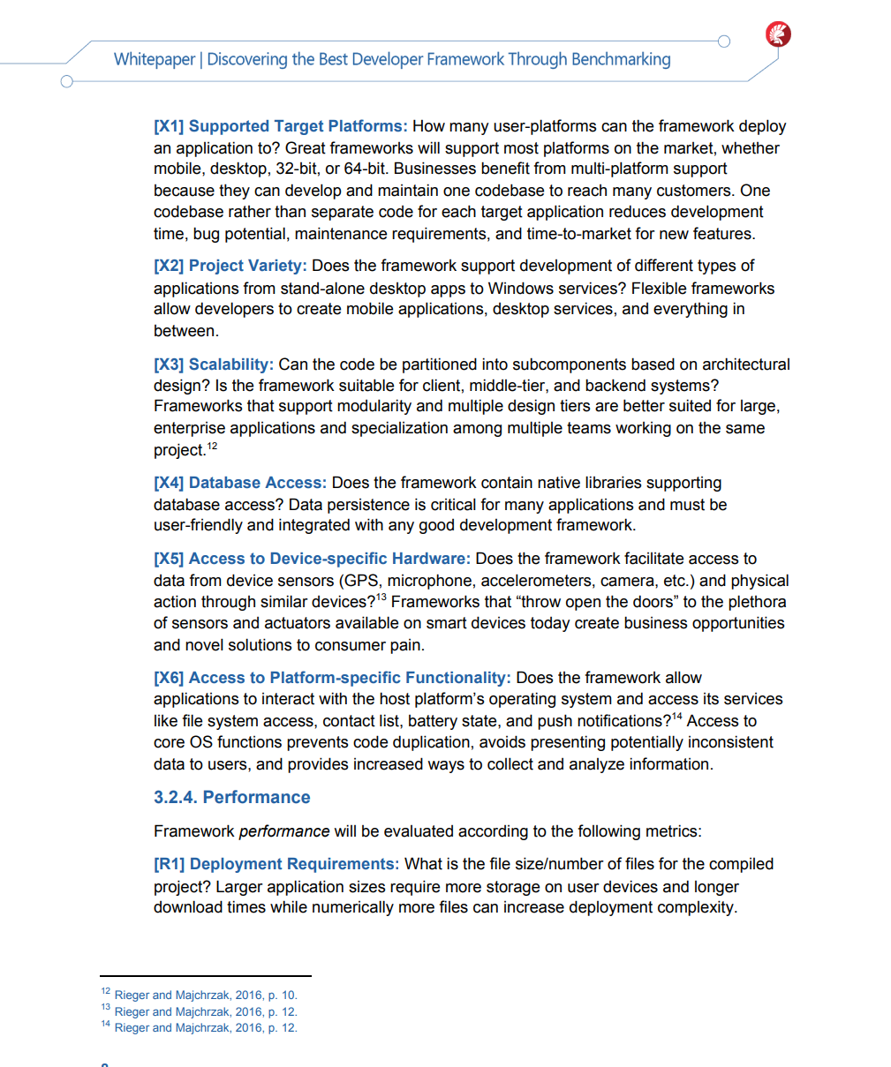
This was a competition, each developer was timed The results of their work were objectively measured according to a set of agnostic criteria Metrics include development time, design approach, total lines of code, and lines of code to implement the user interface
How did we do?

Slide 29
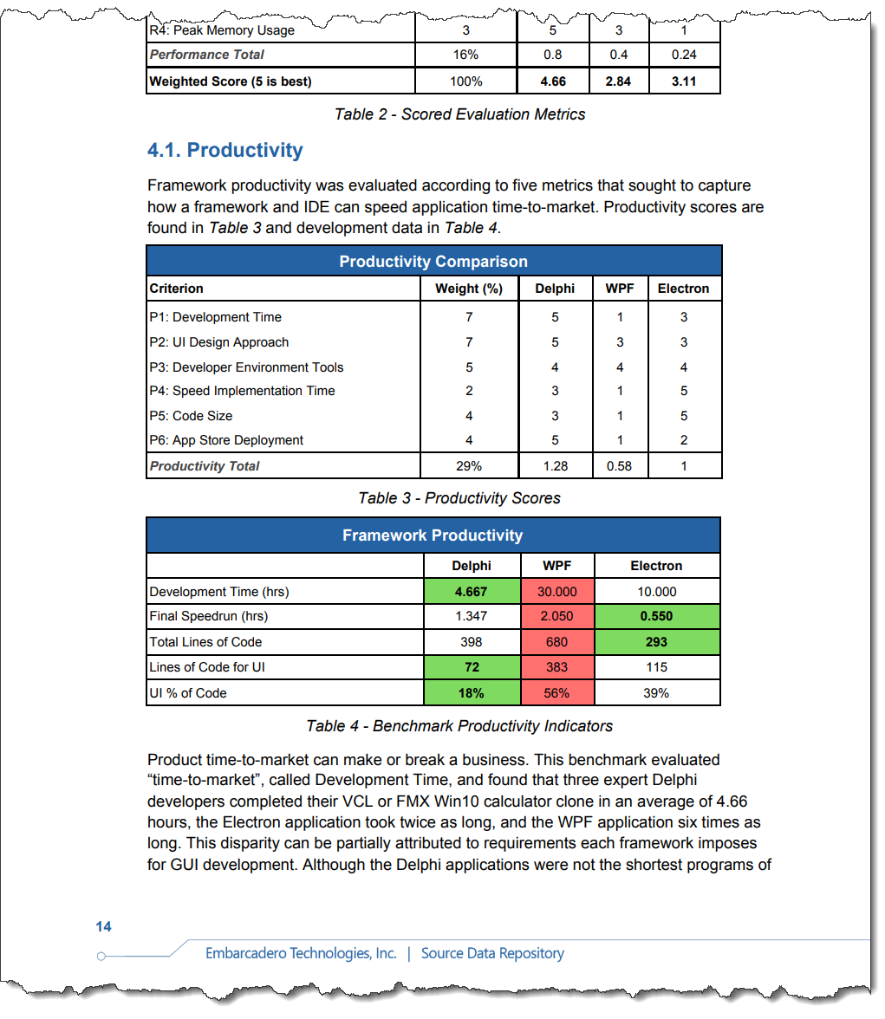
The Delphi developers absolutely CRUSHED IT Delphi was way ahead Electron did better but came second Surprisingly, WPF lost on all metrics
How did we do?

Slide 30
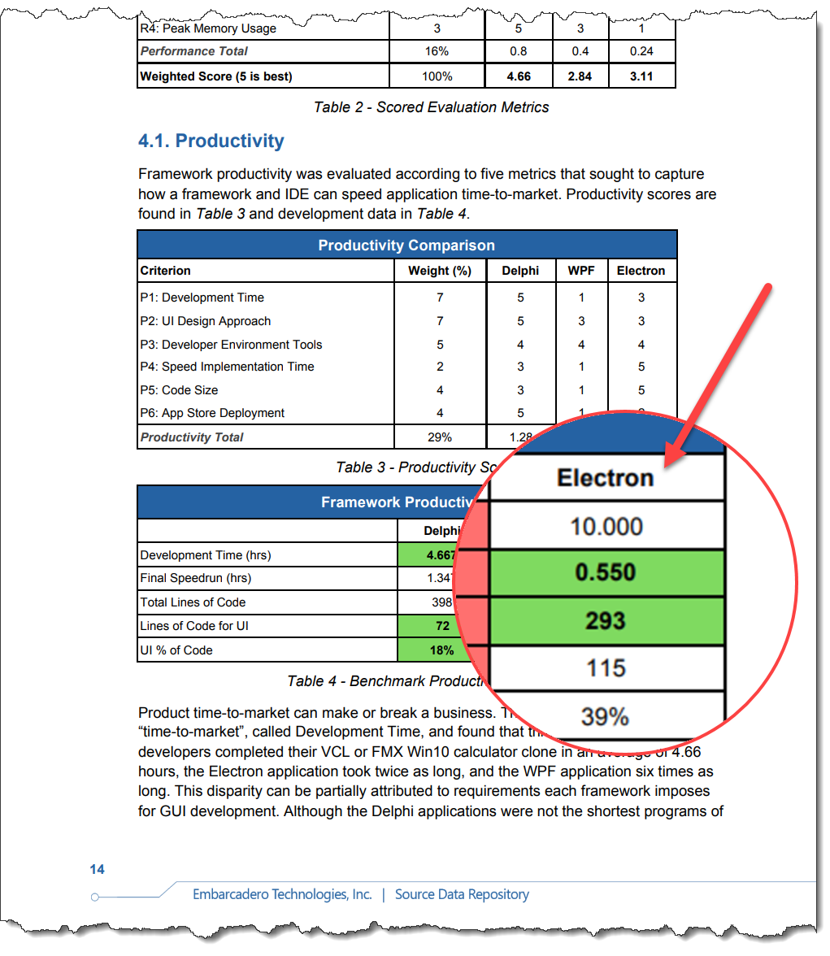
But did you notice something? Electron took ten hours to develop After I produced my TMS WEB Core HTML version which took me around an hour… …it took me under five minutes to create an Electron version simply by selecting Electron as the target in RAD Studio 😃
How did we do?

Slide 31
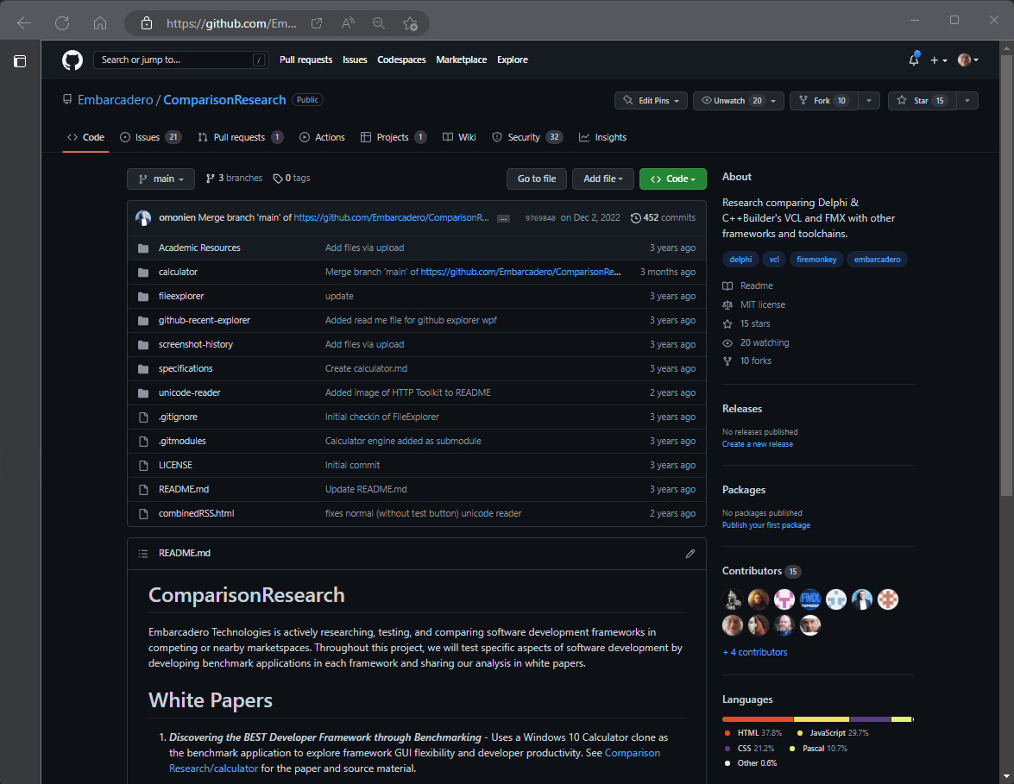
To read more about this research you can download the White Paper
More information
https://lp.embarcadero.com/Discovering_the_best_framework
There is also a GitHub repository with the code from the various projects along with other useful materials
https://github.com/Embarcadero/ComparisonResearch

Slide 32

RAD Studio
There is NOTHING you can’t do using RAD Studio with Delphi
Run your apps on a Raspberry Pi? There is a solution for that, and it works today.
Run on a cheap Amazon Fire tablet? Target Android – it will run just fine!
Target Windows, macOS (Intel and Arm), iOS, Android, even the web from a SINGLE code base and project? Yes, it’s absolutely a fact
Keep running even after the whole operating system has been upgraded without needing any new downloads or reconfiguration? Yes.
That’s why I choose Delphi

Slide 33

How we used Delphi as a weapon in a real fight - and won
Ian Barker
Embarcadero Delphi MVP
ian.barker@gmail.com
@punctuation
about.me/IanBarker
Slides, link & replay tinyurl.com/delphivscompetition

